Slide 1
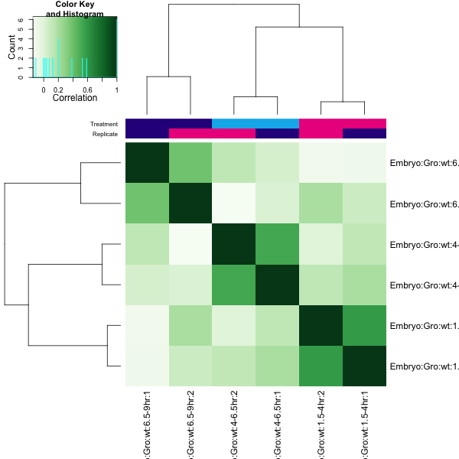
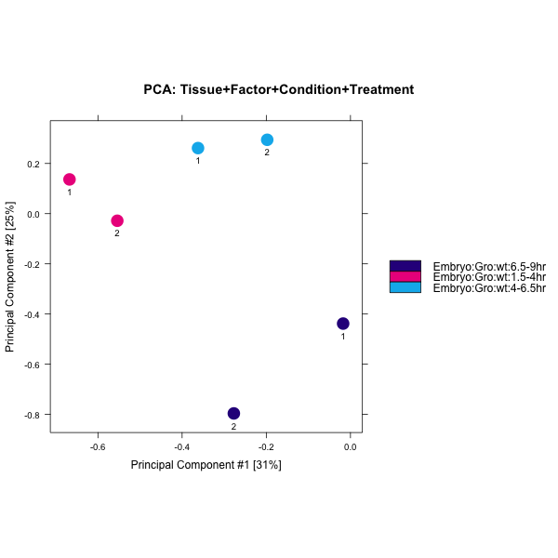
Fig. 2-1
A
B
C

Slide 2
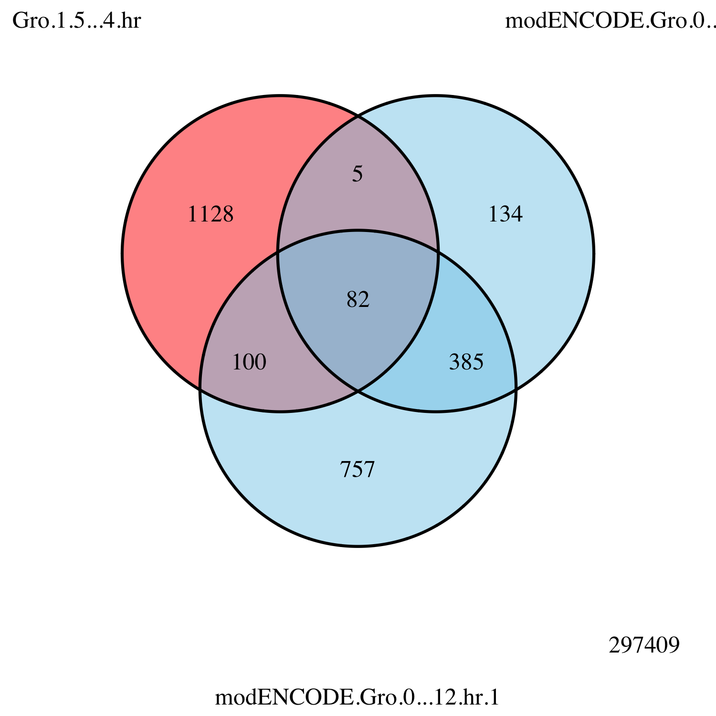
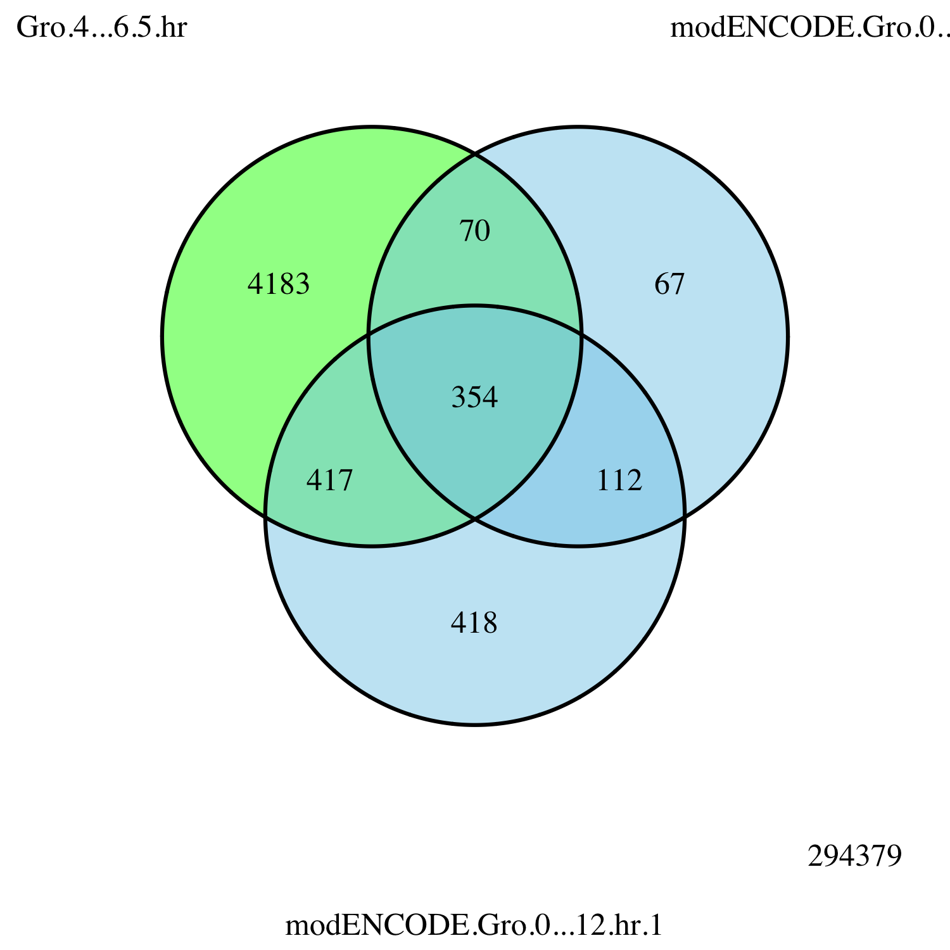
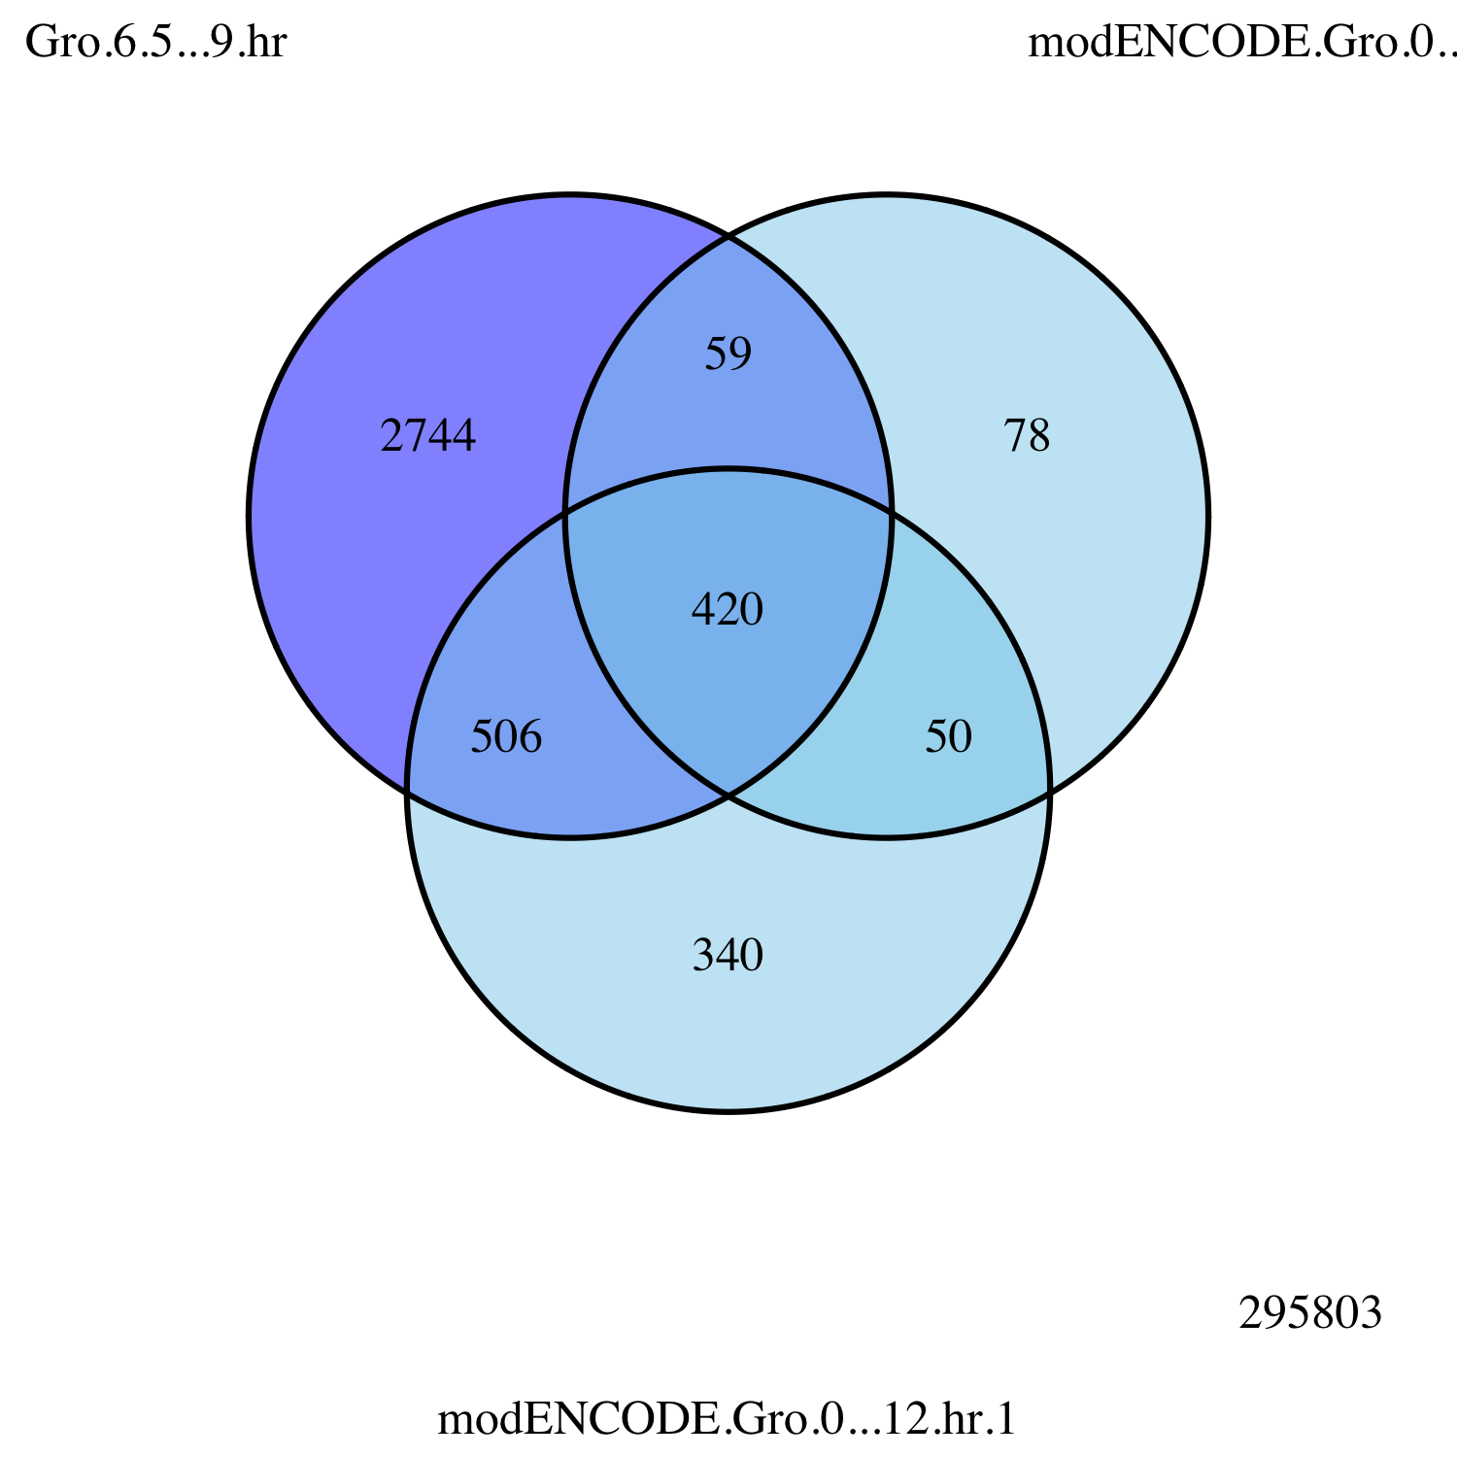
Fig. 2-2
Embryo
0 – 12 hr
Rep 2
Embryo
1.5 – 4 hr
Embryo
0 – 12 hr
Rep 1
Embryo
0 – 12 hr
Rep 2
Embryo
4 – 6.5 hr
Embryo
0 – 12 hr
Rep 1
Embryo
0 – 12 hr
Rep 2
Embryo
6.5 – 9 hr
Embryo
0 – 12 hr
Rep 1

Slide 3
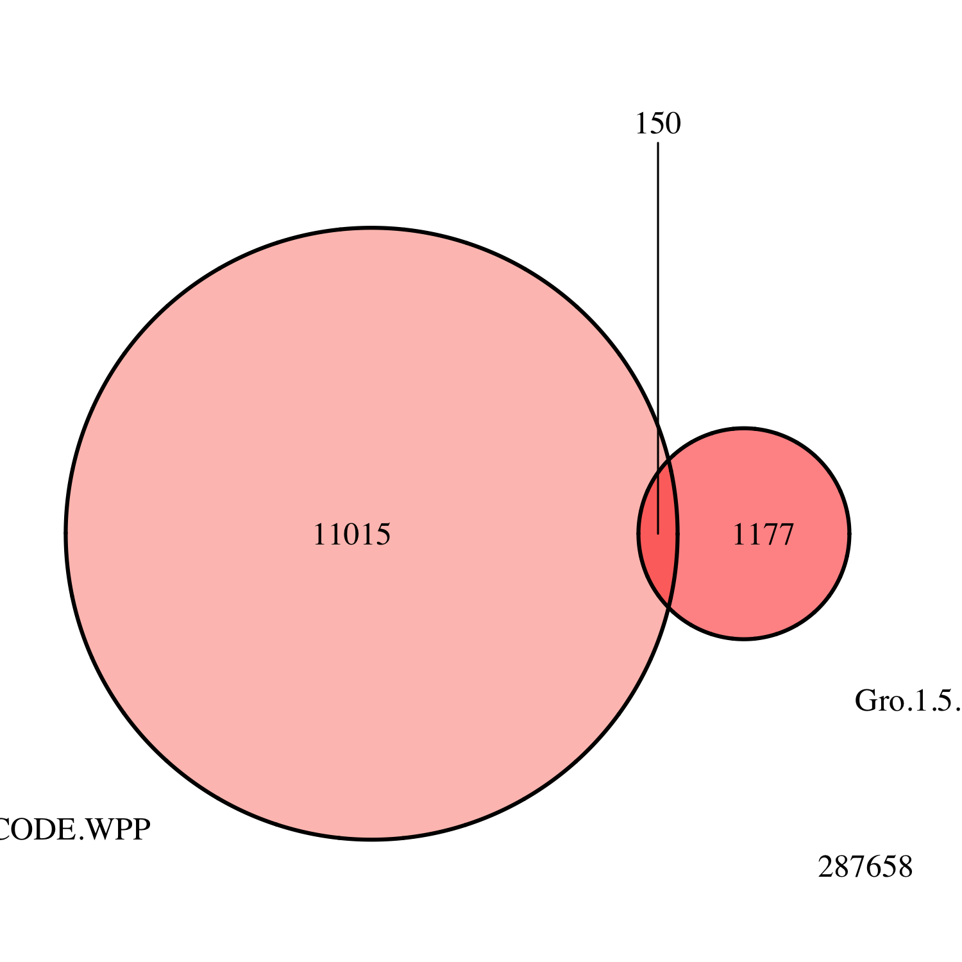
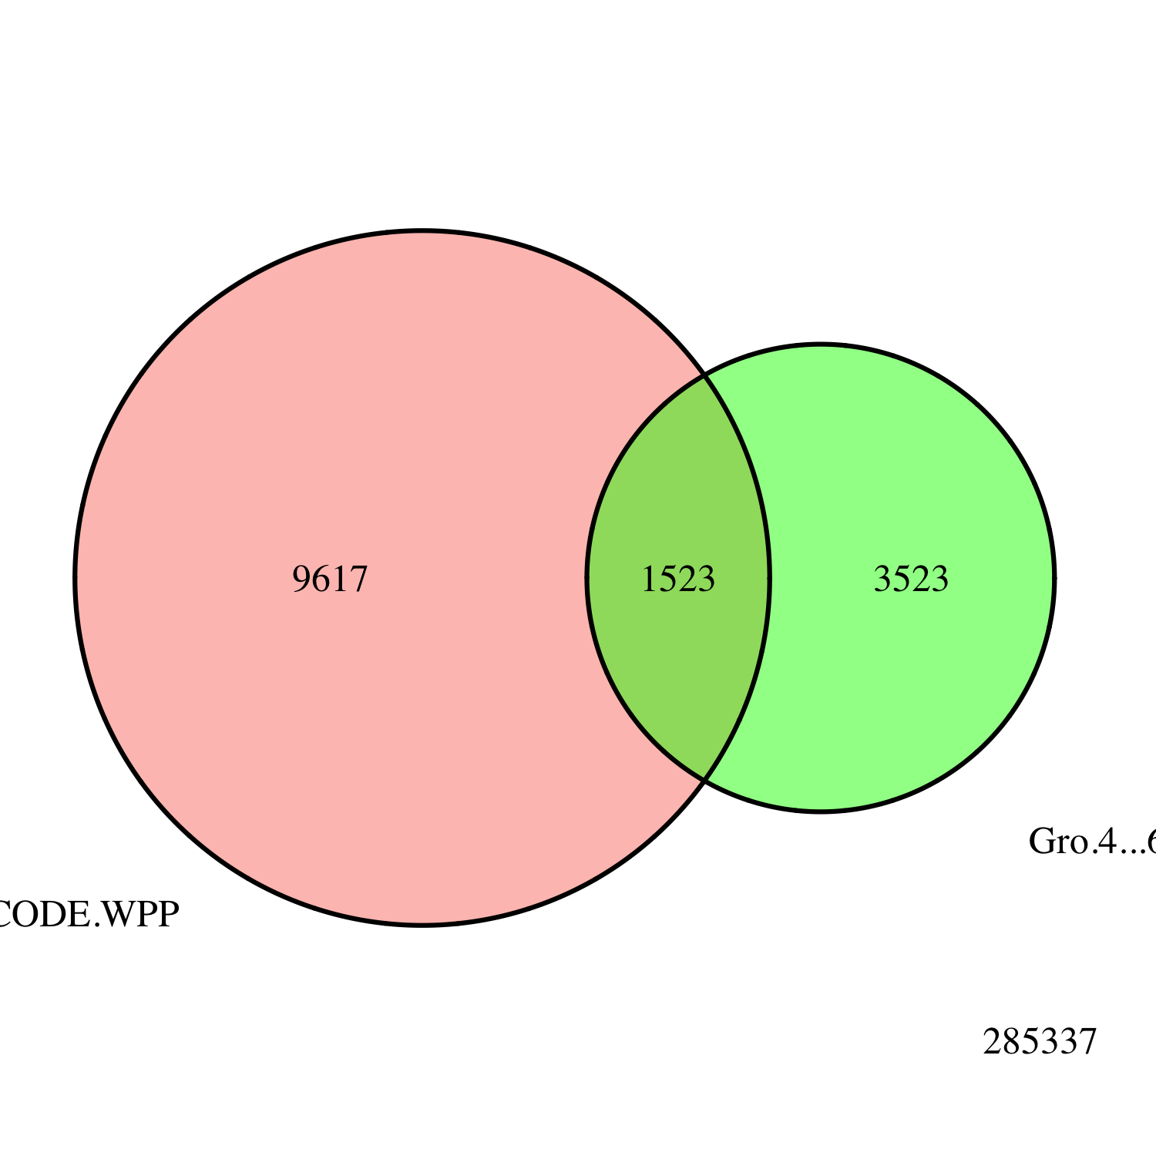
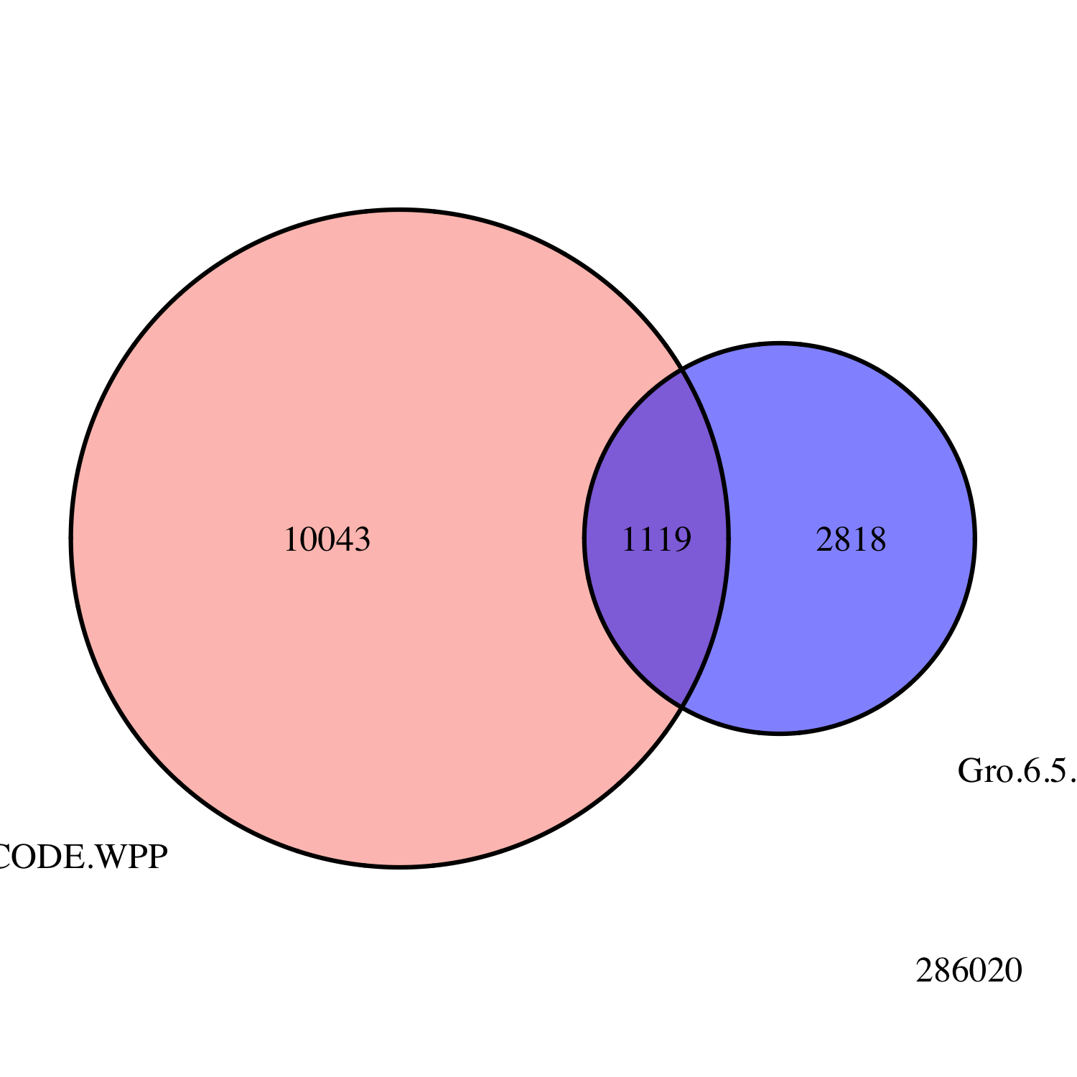
Fig. 2-3
Embryo
1.5 – 4 hr
modENCODE
White Pre-Pupae
Embryo
4 – 6.5 hr
Embryo
6.5 – 9 hr

Slide 4
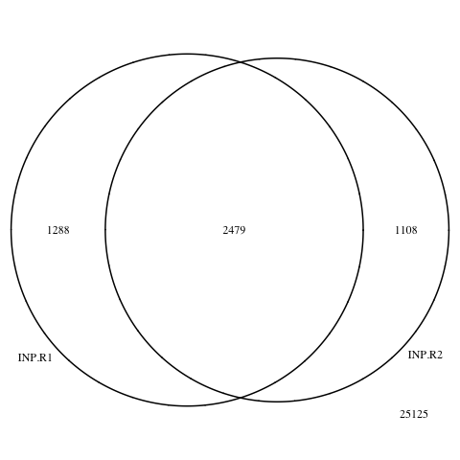
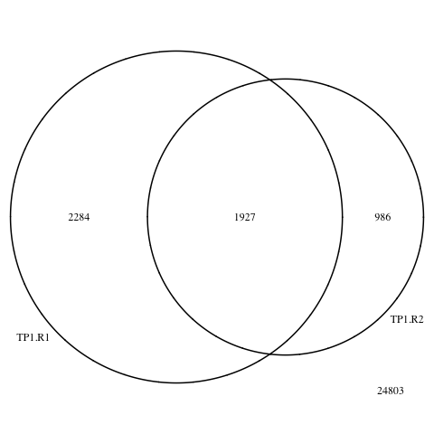
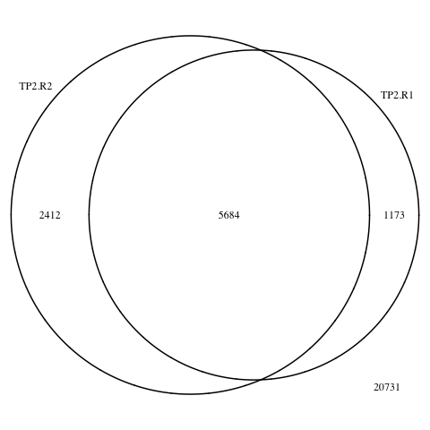
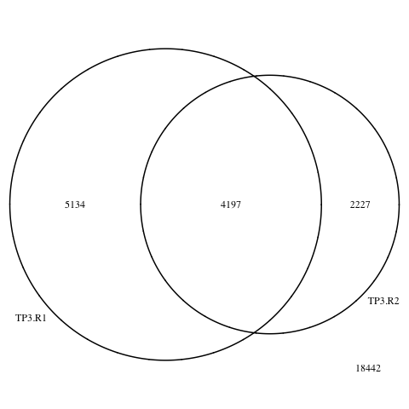
Fig. 2-4
Input
1.5 – 4 hr
4 – 6.5 hr
6.5 – 9 hr

Slide 5
Fig. 2-5
A
B

Slide 6
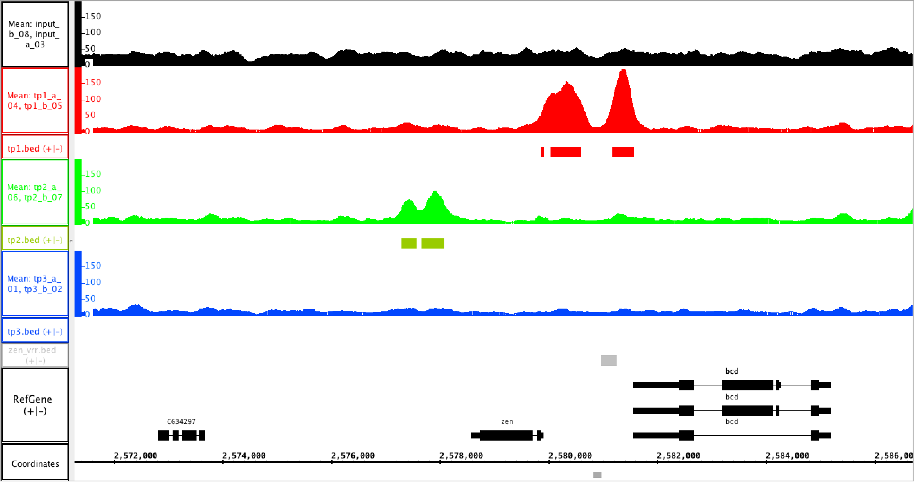
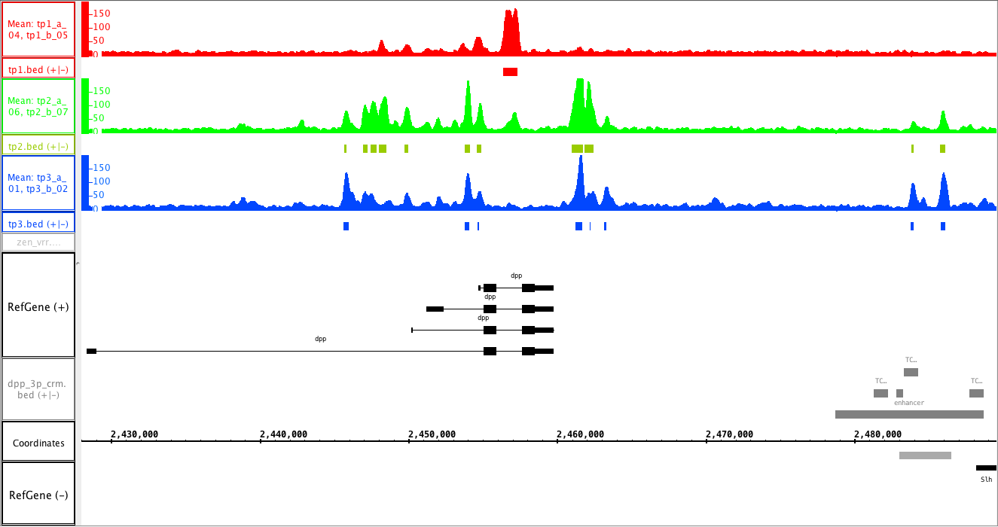
Fig. 2-6
A
1.5 – 4 hr
4 – 6.5 hr
6.5 – 9 hr
VRR
B
1.5 – 4 hr
4 – 6.5 hr
6.5 – 9 hr

Slide 7
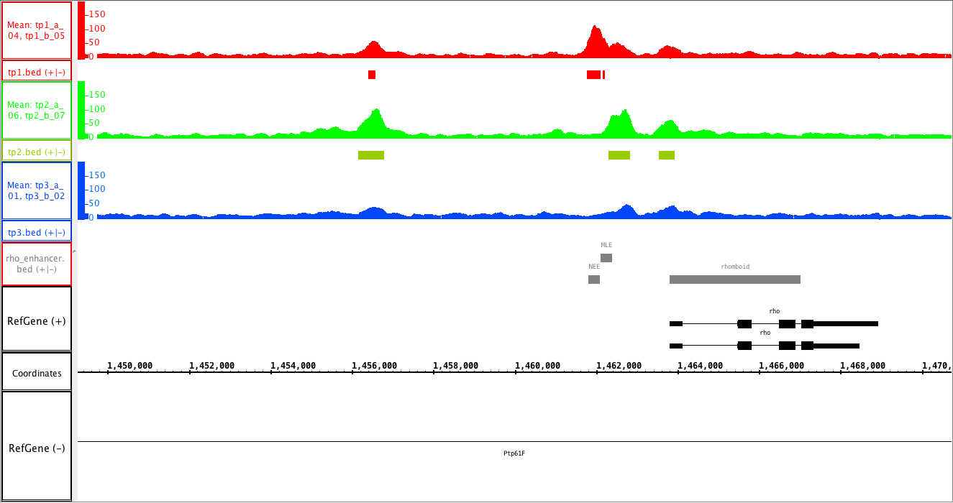
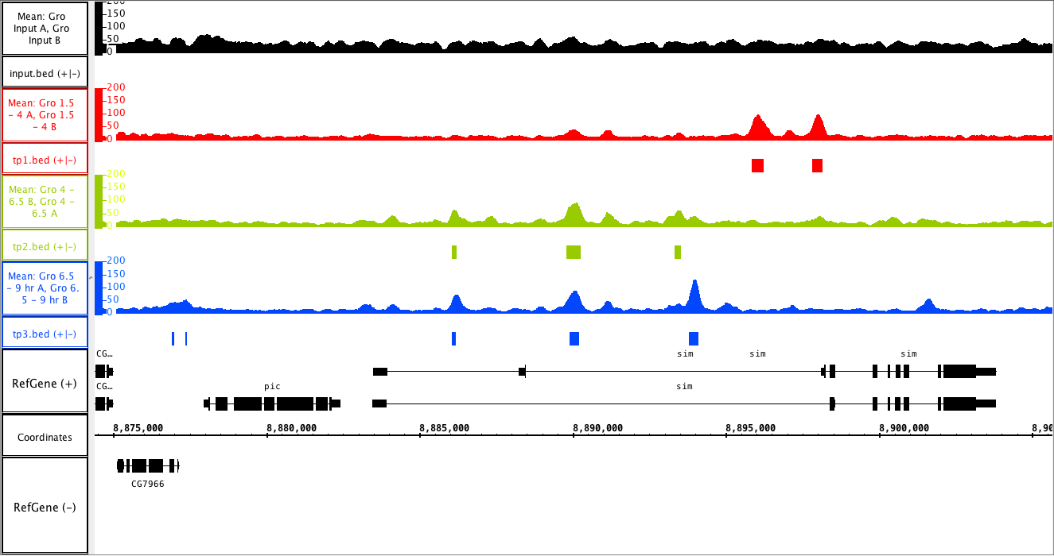
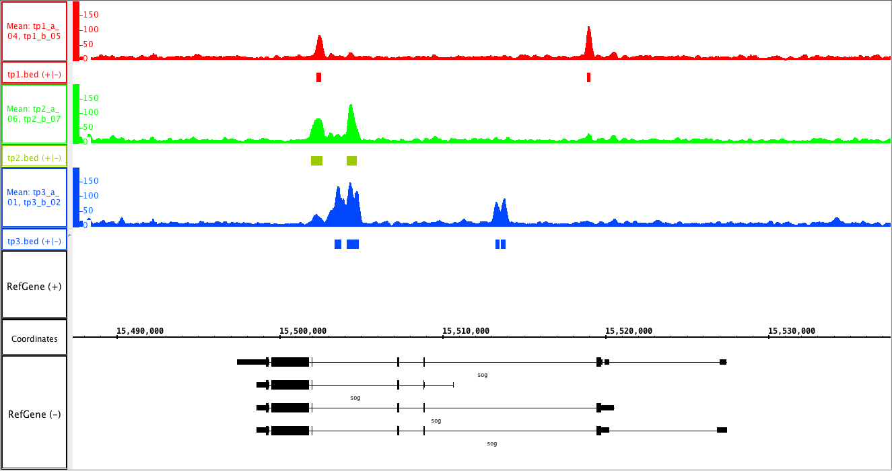
Fig. 2-7
A
1.5 – 4 hr
4 – 6.5 hr
6.5 – 9 hr
B
1.5 – 4 hr
4 – 6.5 hr
6.5 – 9 hr
C
1.5 – 4 hr
4 – 6.5 hr
6.5 – 9 hr

Slide 8
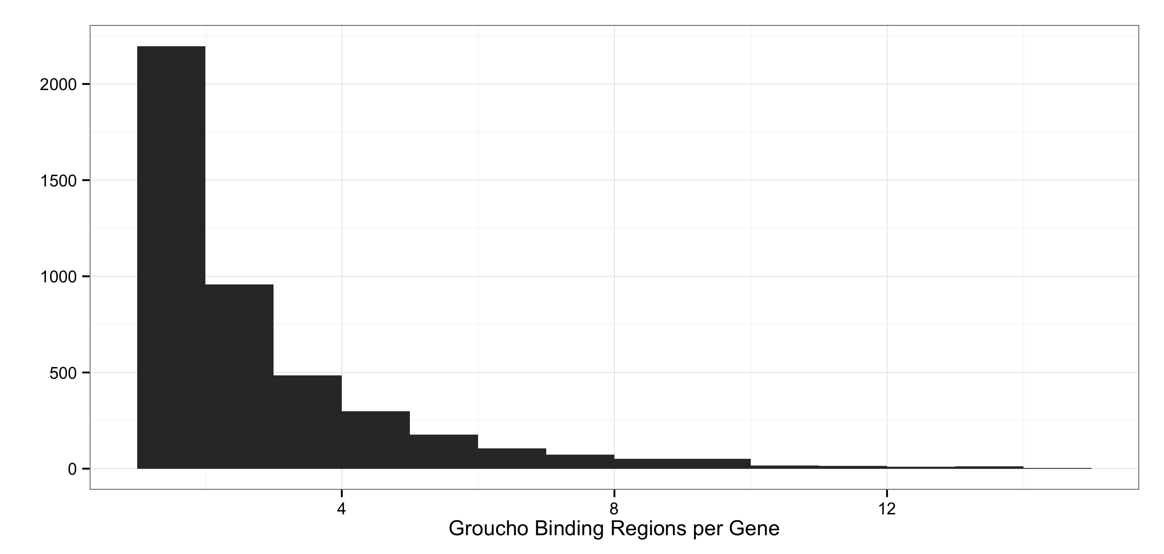
Fig. 2-8
A
B

Slide 9
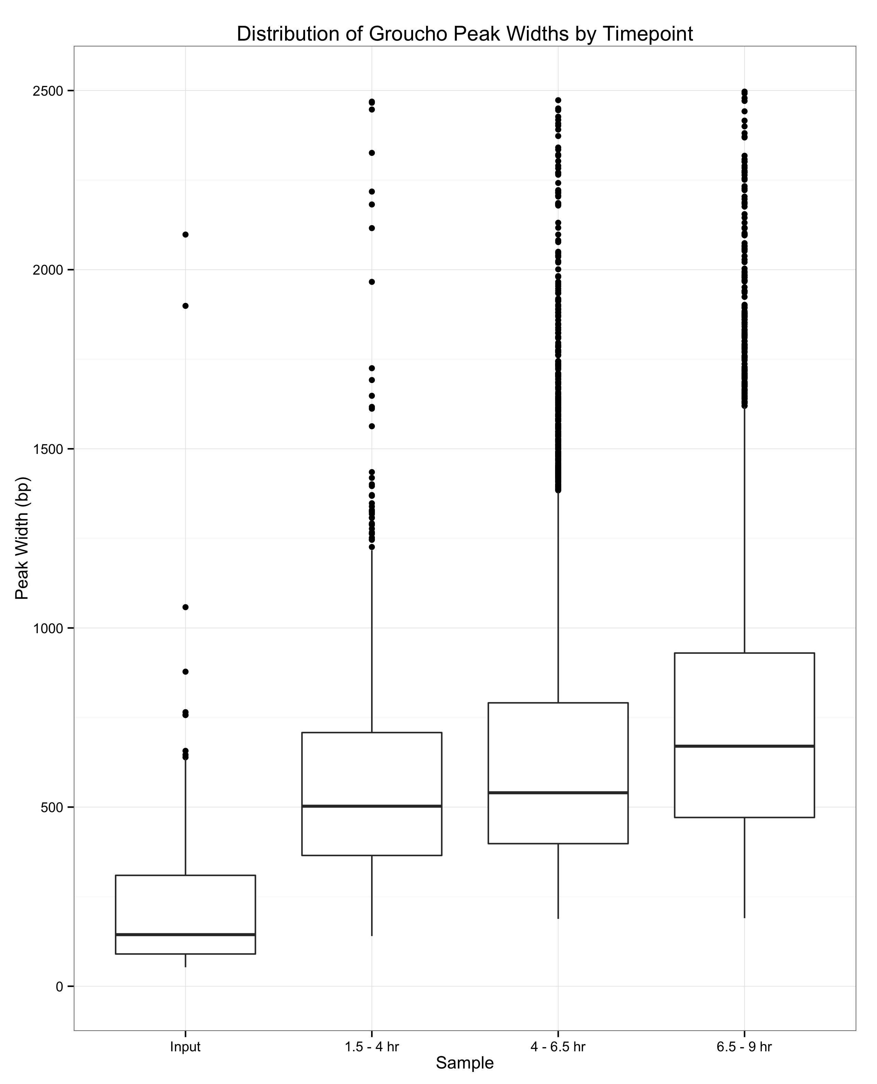
Fig. 2-9

Slide 10
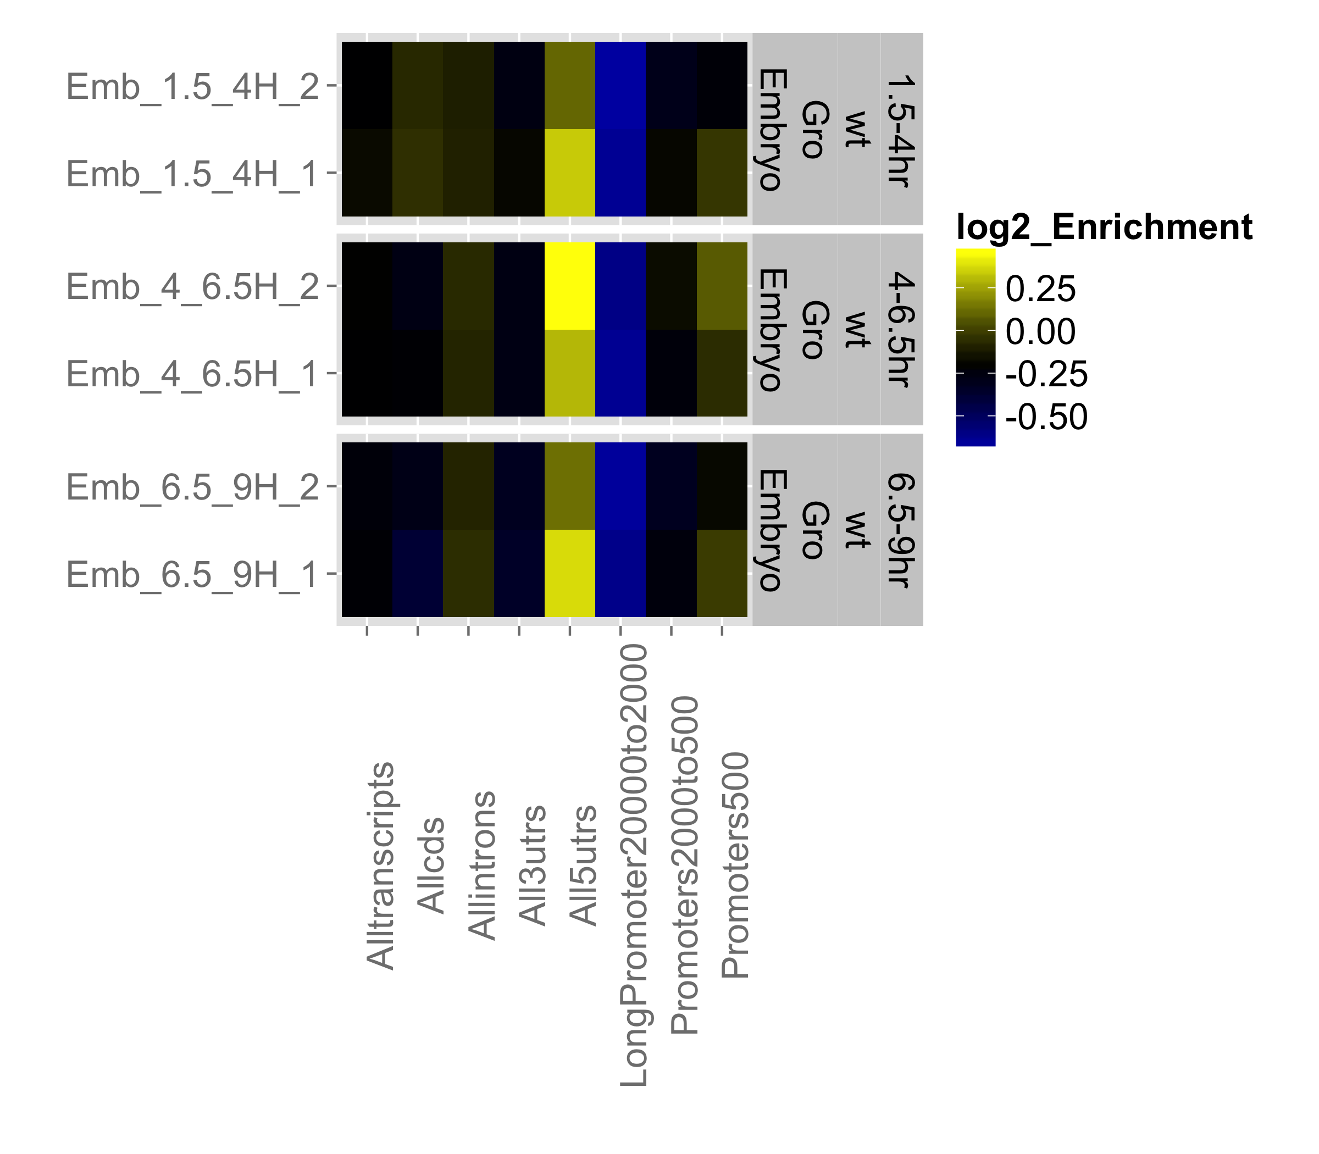
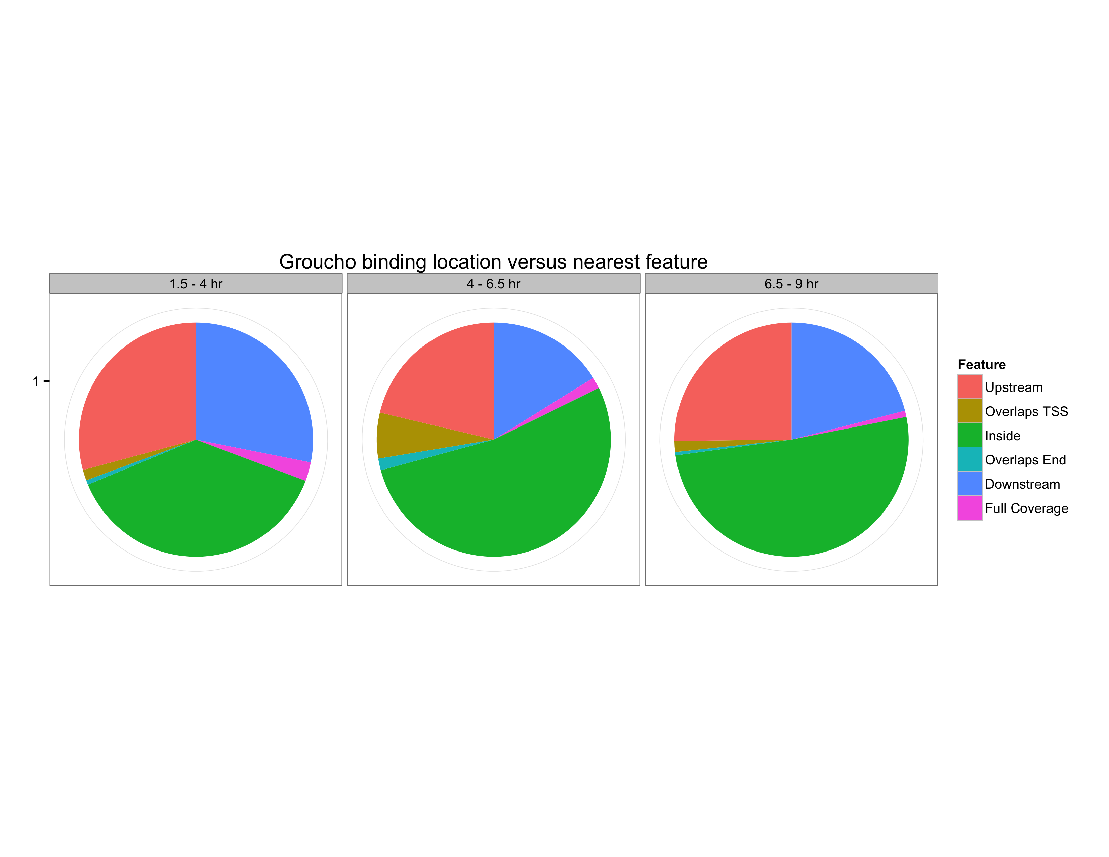
Fig. 2-10
A
B

Slide 11
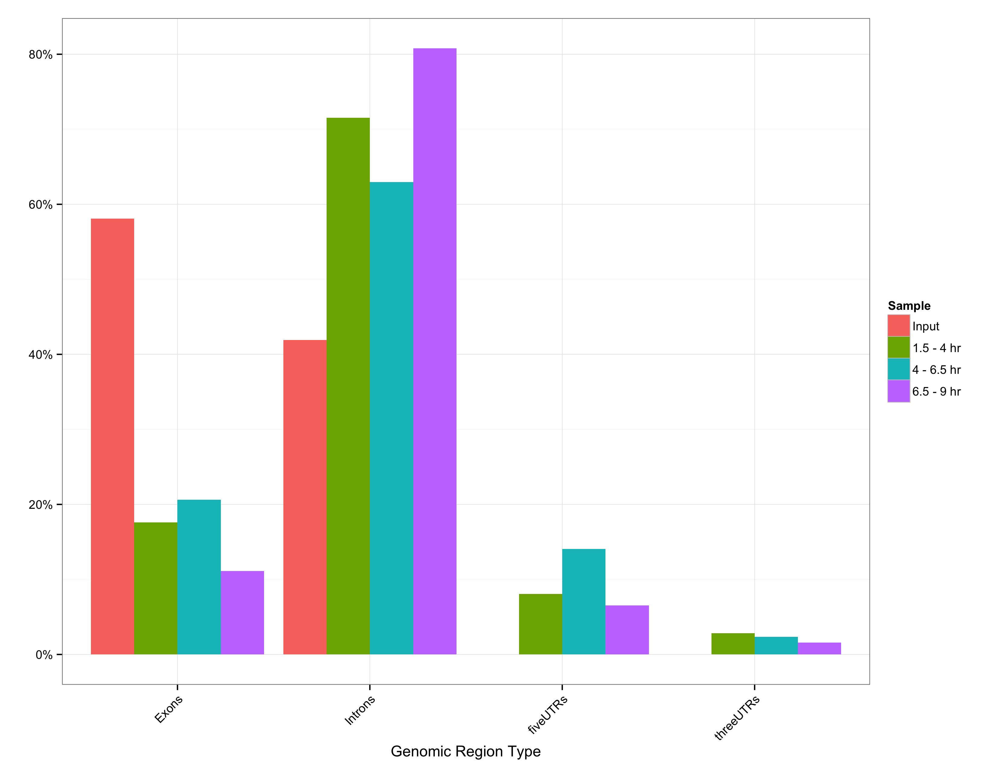
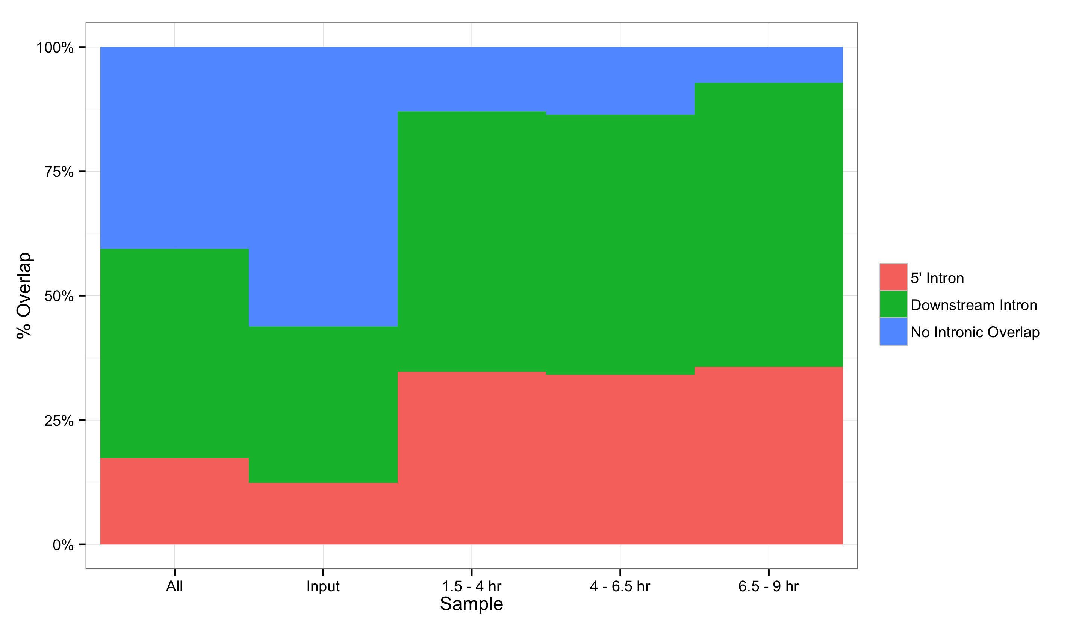
Fig. 2-11
A
B

Slide 12
Fig. 2-12

Slide 13
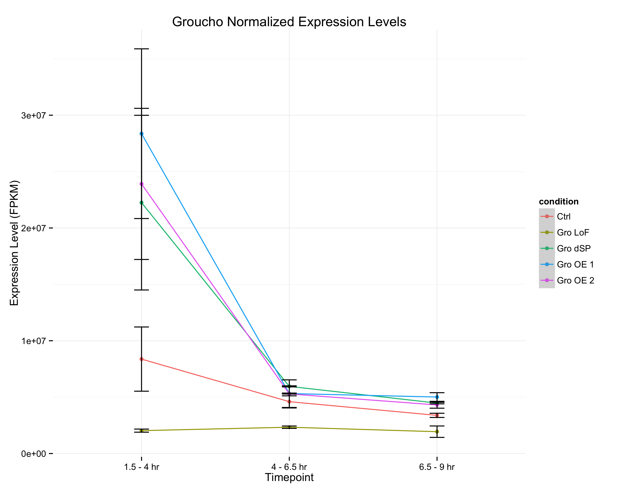
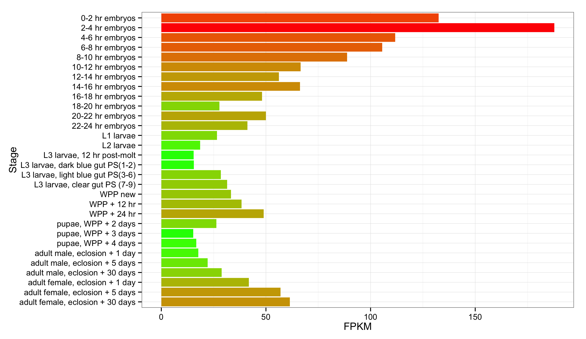
Fig. 2-13
A
Groucho transcript abundance
modENCODE Developmental Transcriptome Project
B

Slide 14
Fig. 2-14

Slide 15
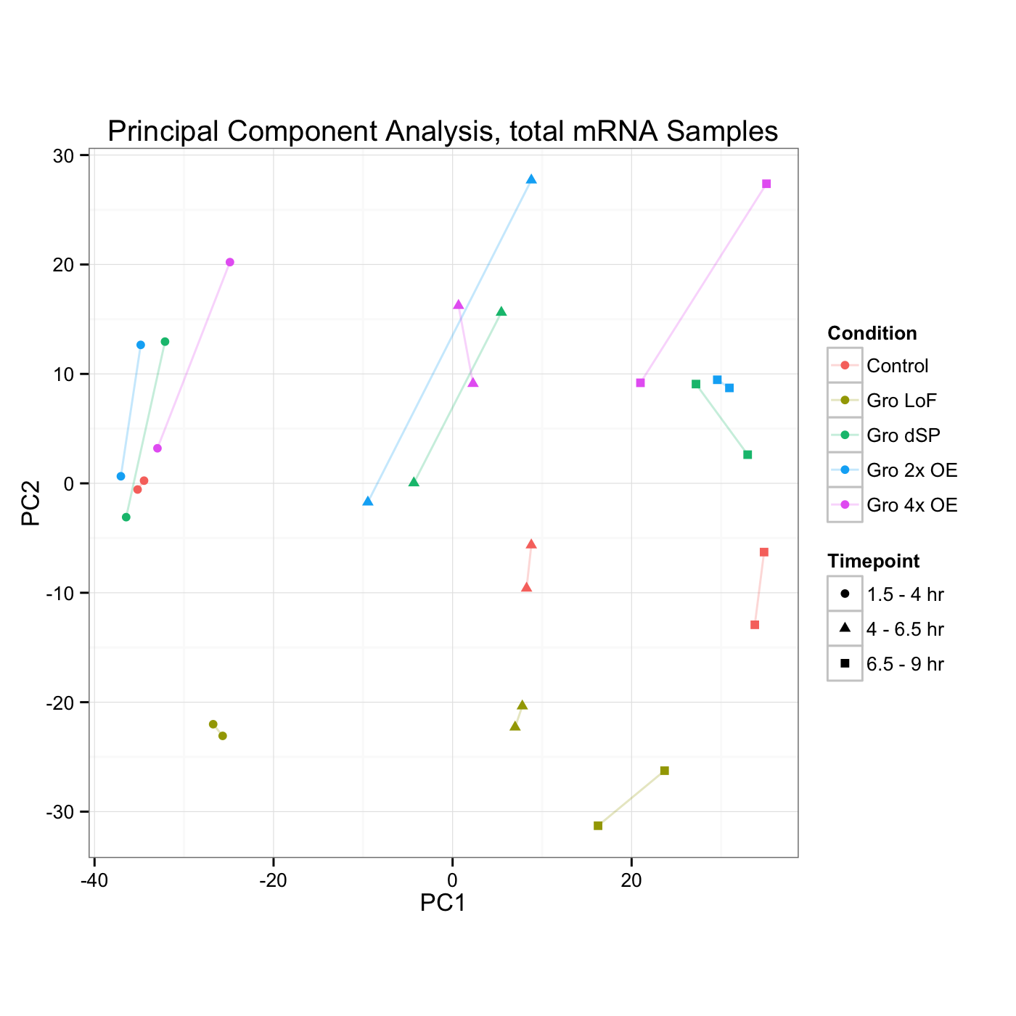
Fig. 2-15
Gro Dosage
Developmental Stage

Slide 16
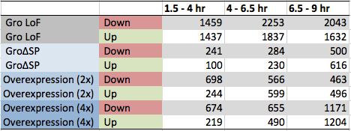
Fig. 2-16
A
B

Slide 17
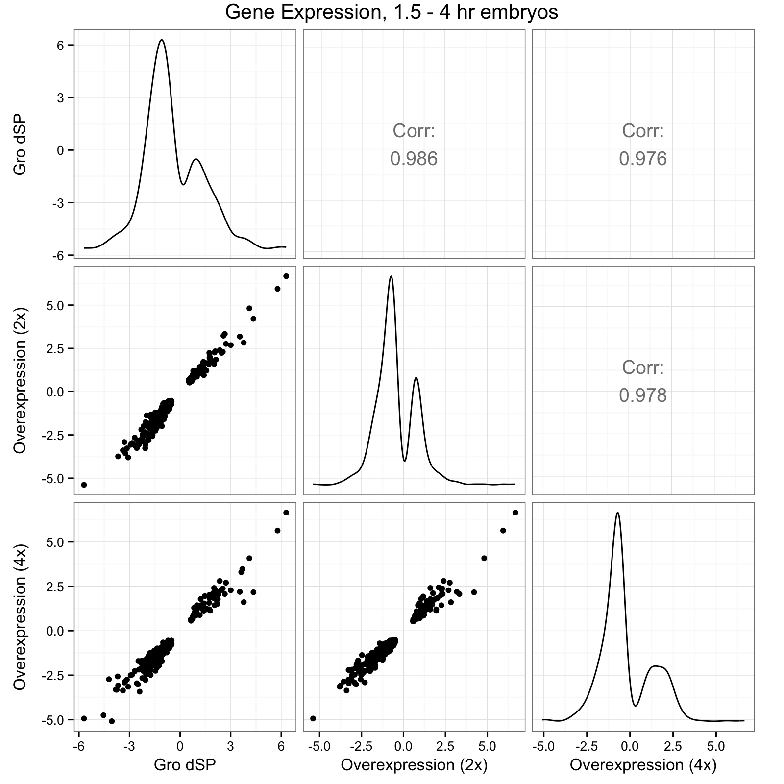
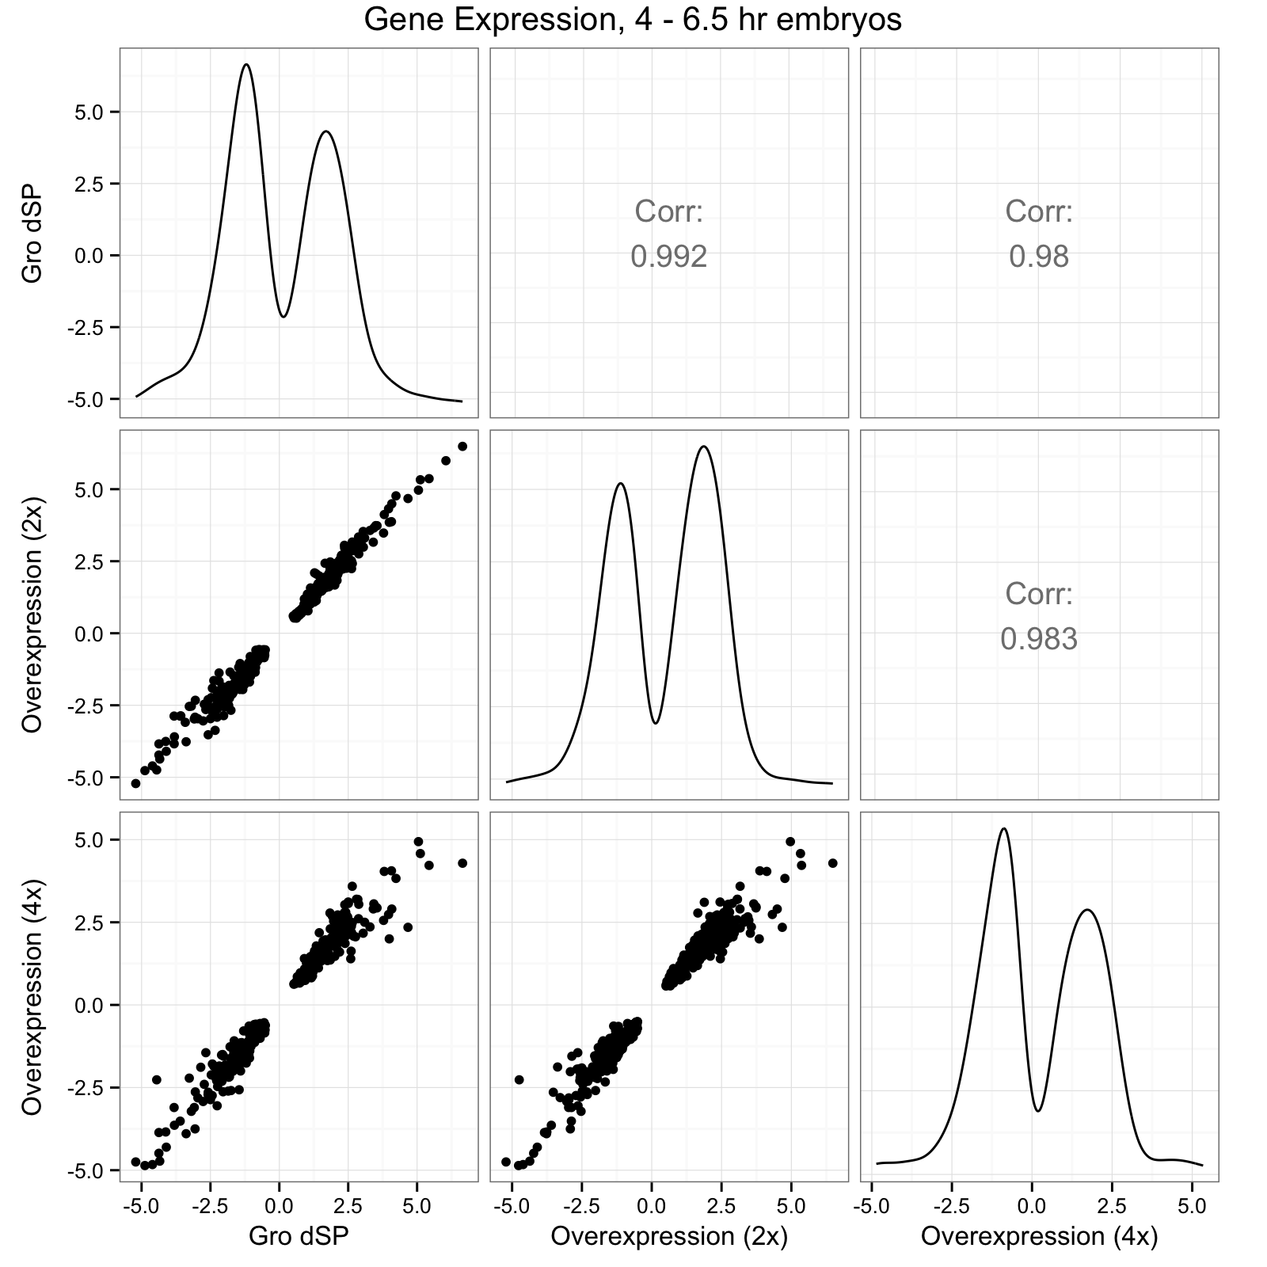
Fig. 2-17
A
B

Slide 18
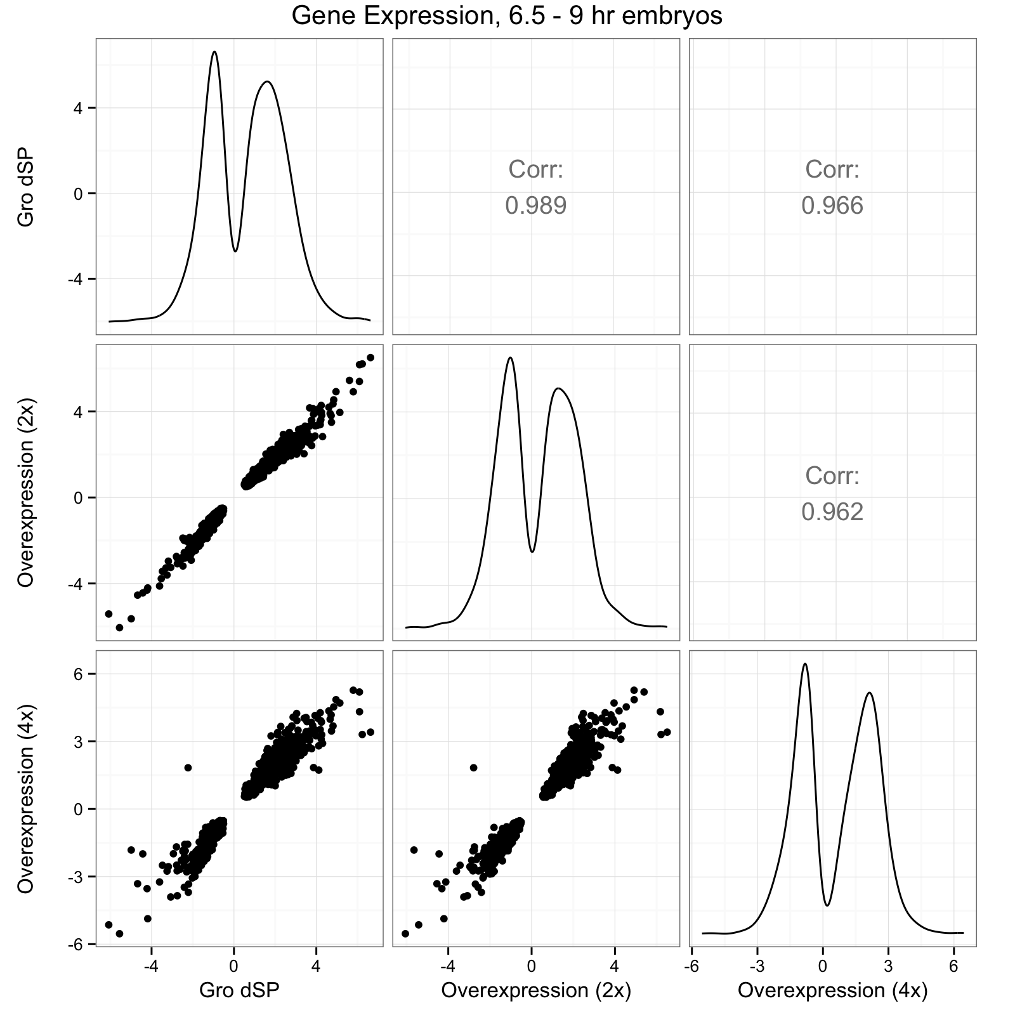
Fig. 2-17 (continued)
C

Slide 19
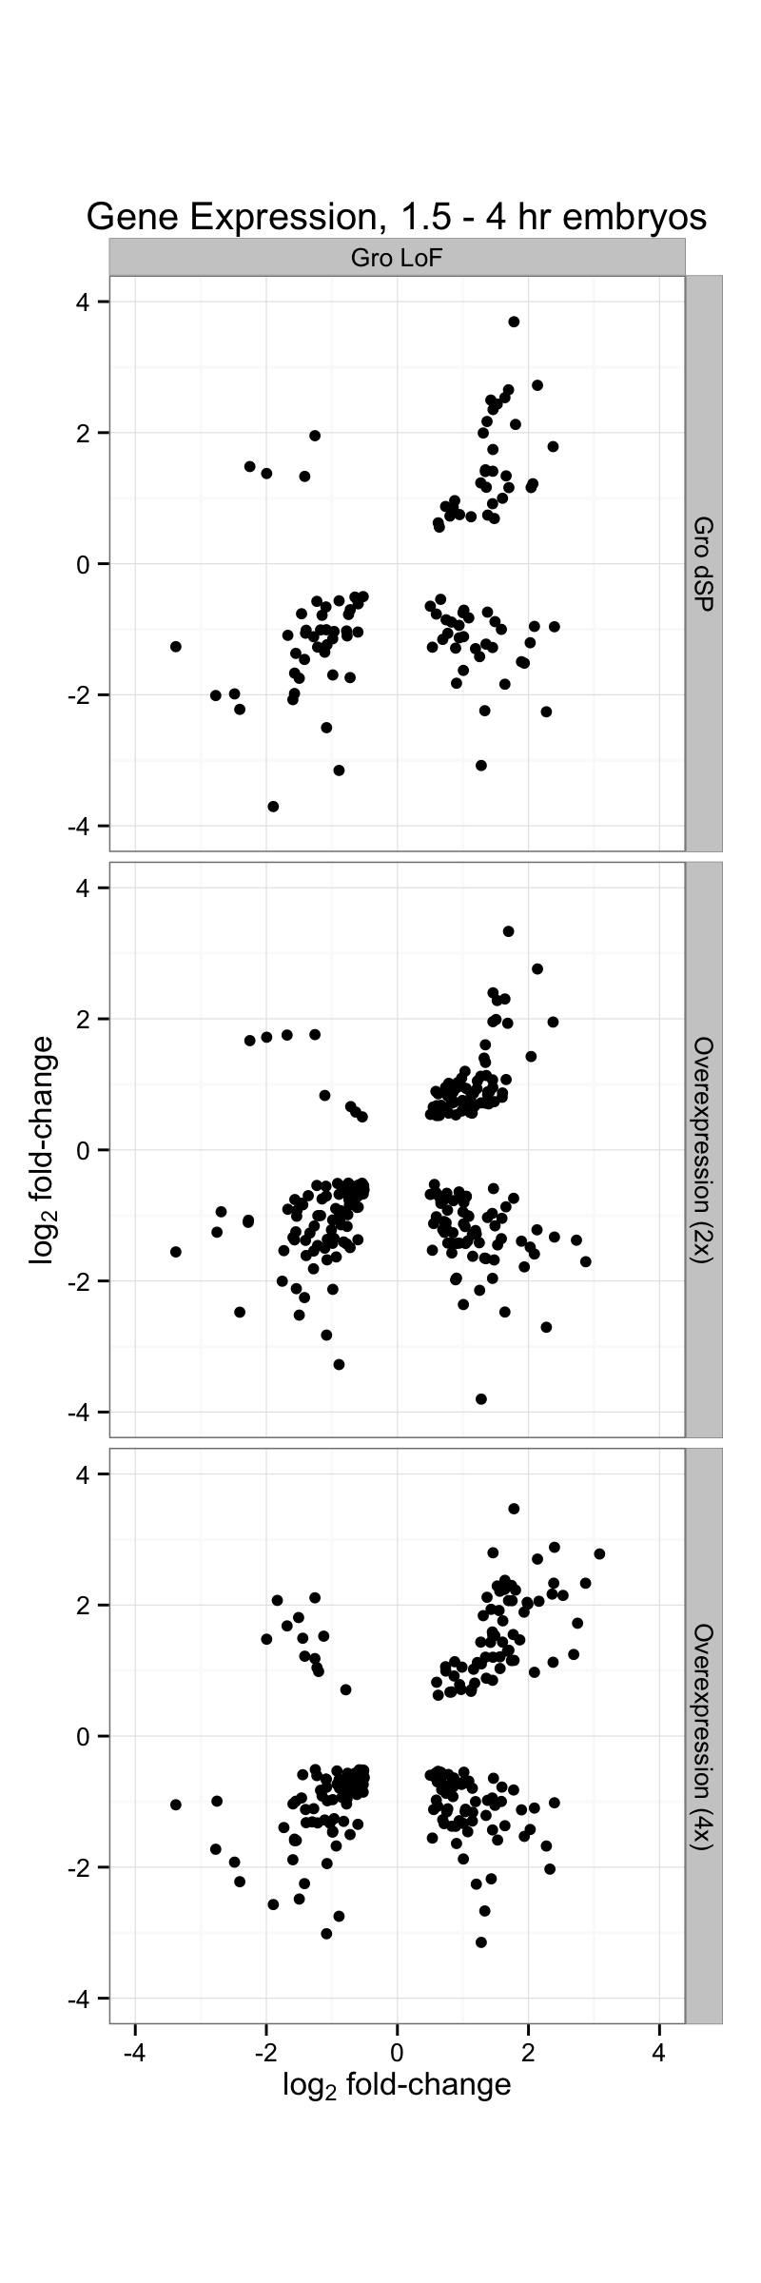
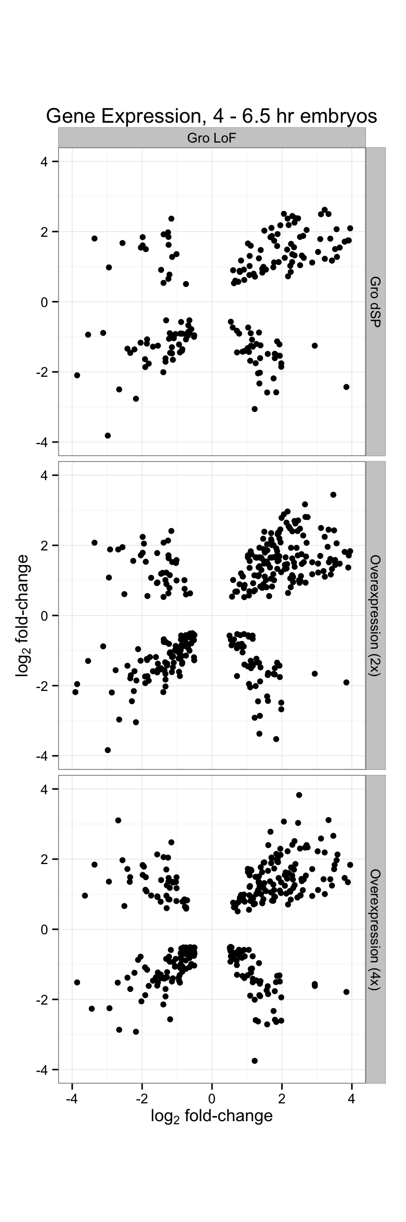
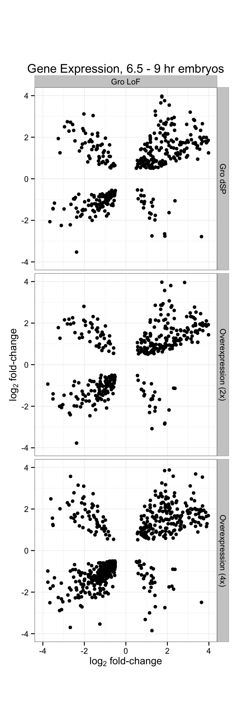
Fig. 2-18

Slide 20
Fig. 2-19
Gro loss-of-function
vs.
2x Gro Overexpression
Gro loss-of-function
vs.
4x Gro Overexpression

Slide 21
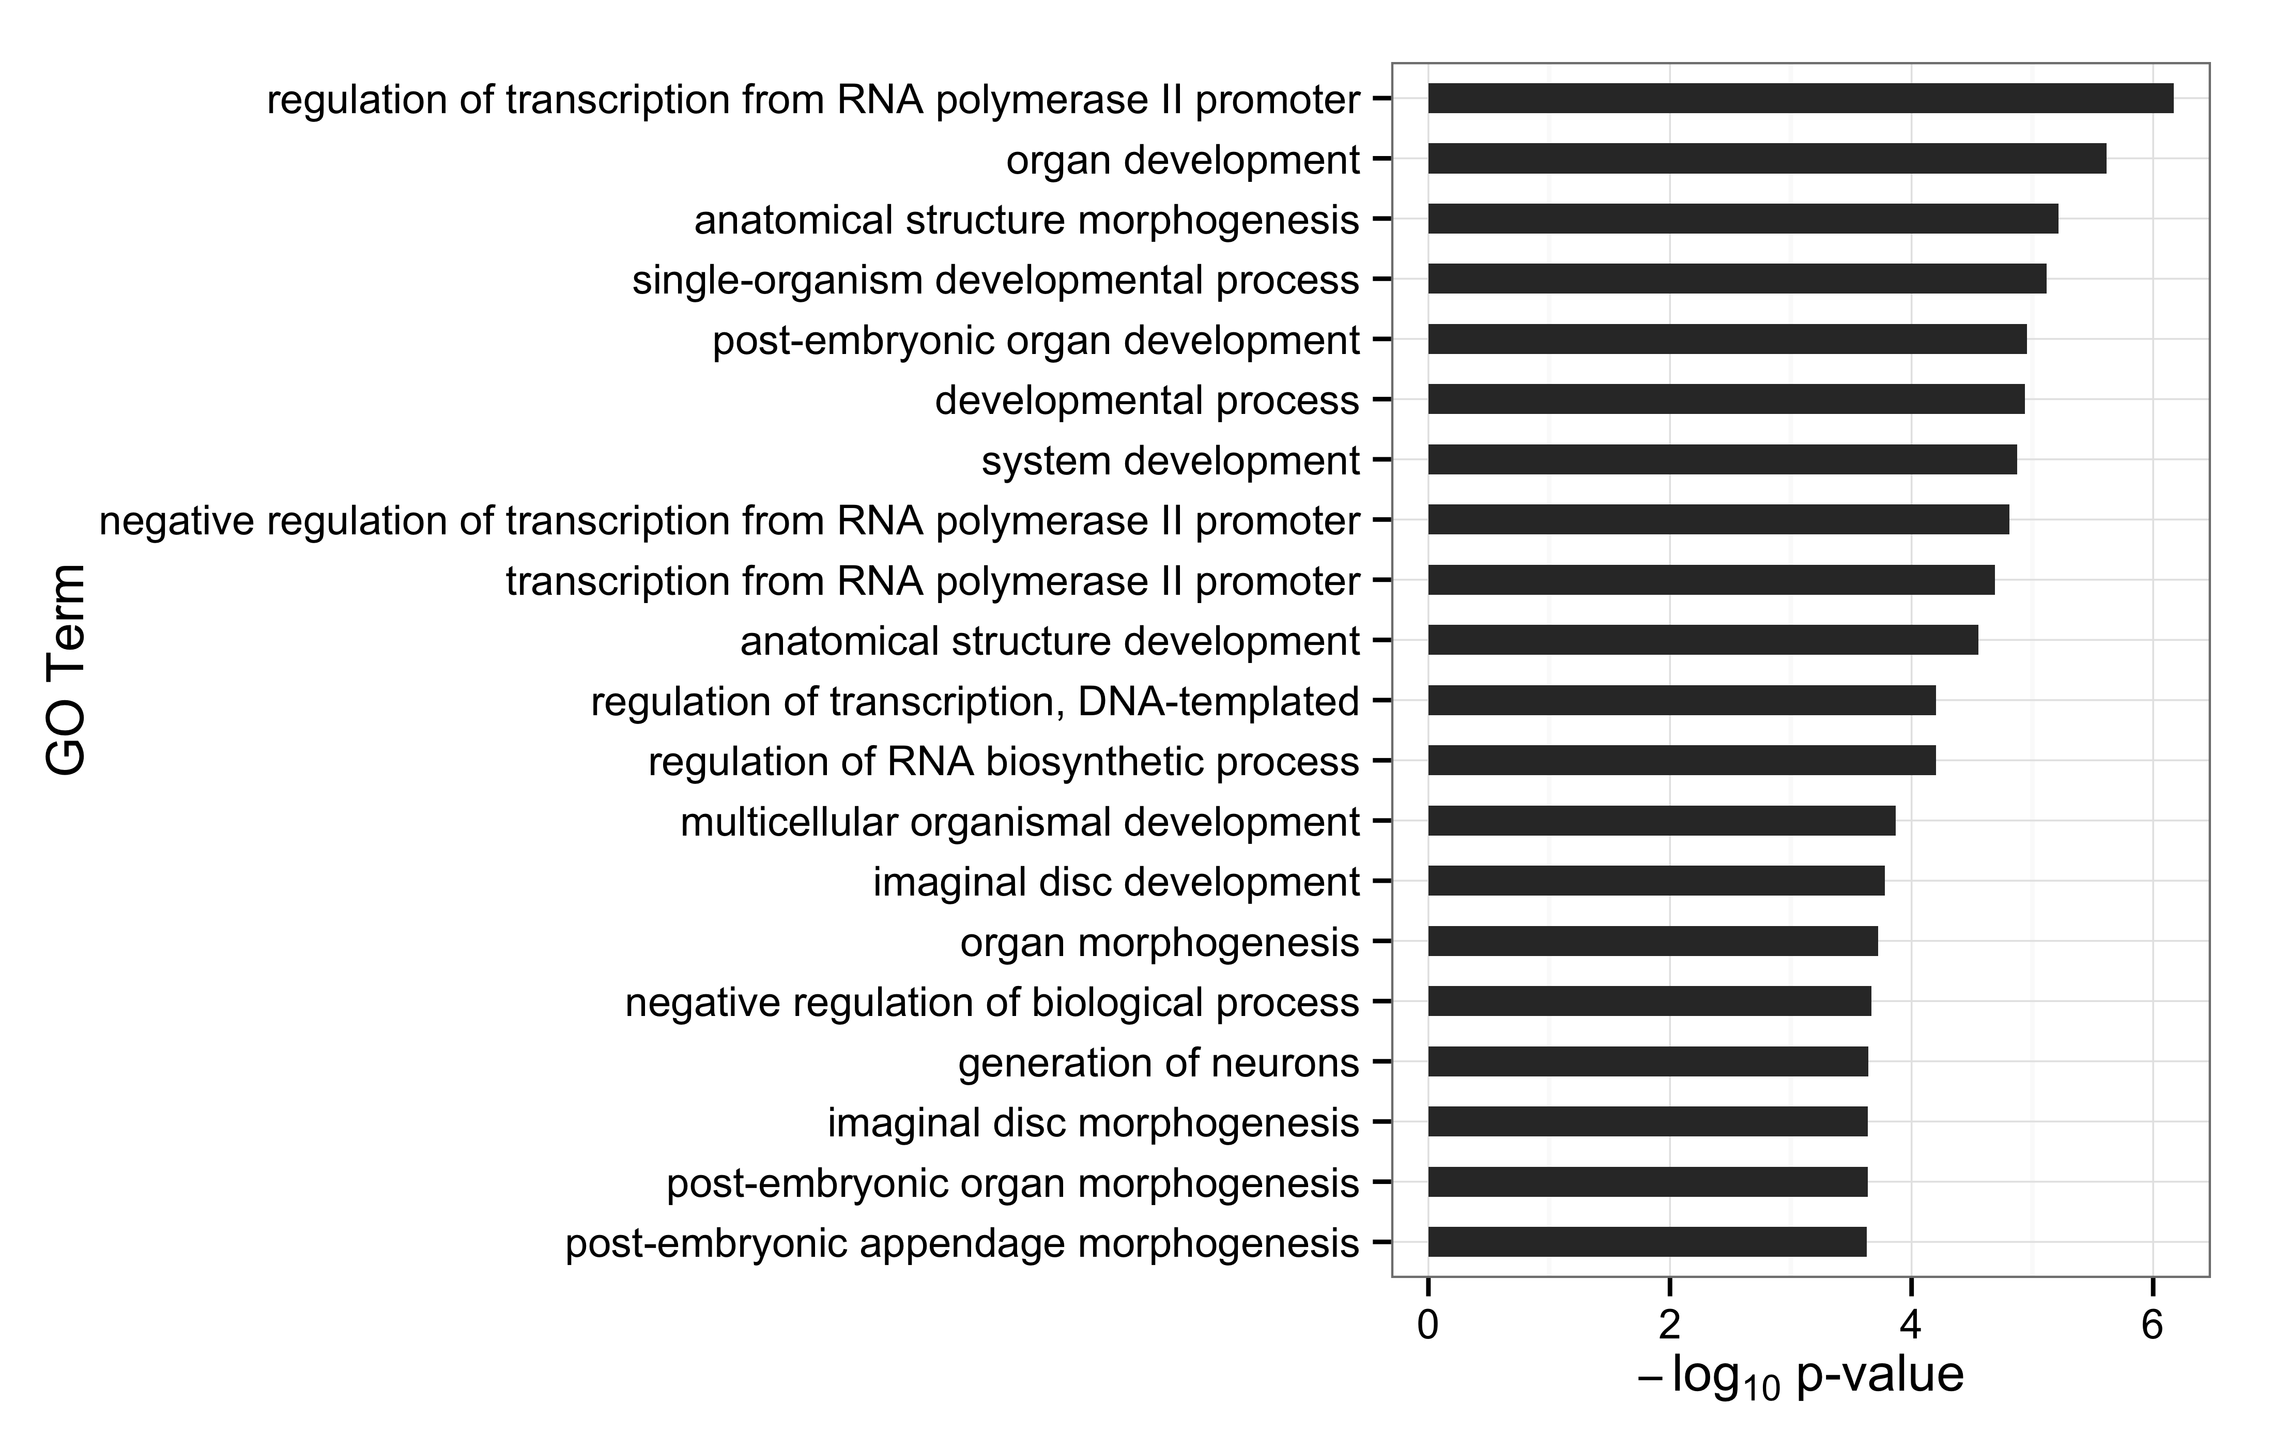
Fig. 2-20

Slide 22
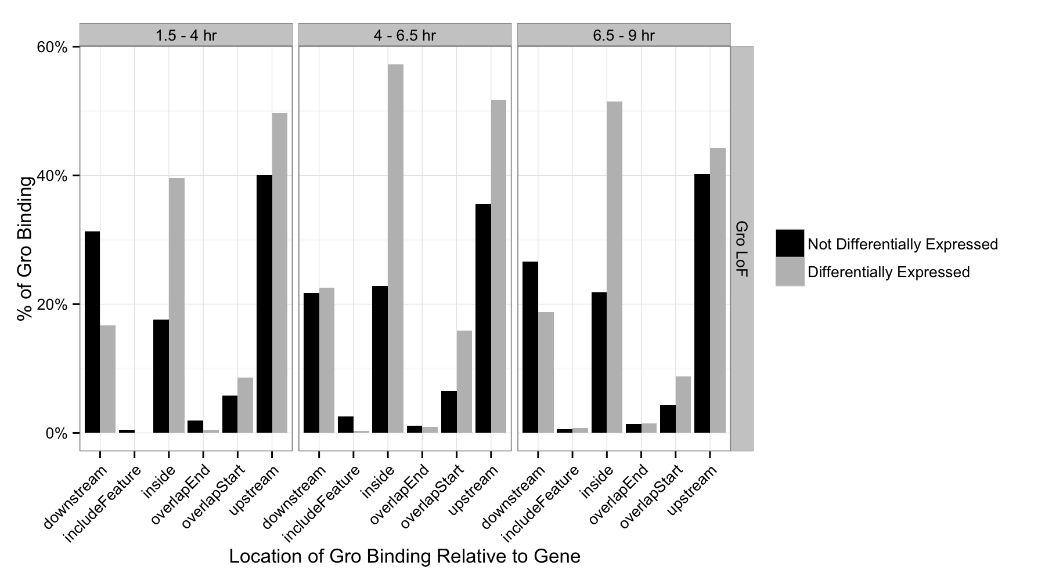
Fig. 2-21
Percentage of genes with internal Groucho binding

Slide 23
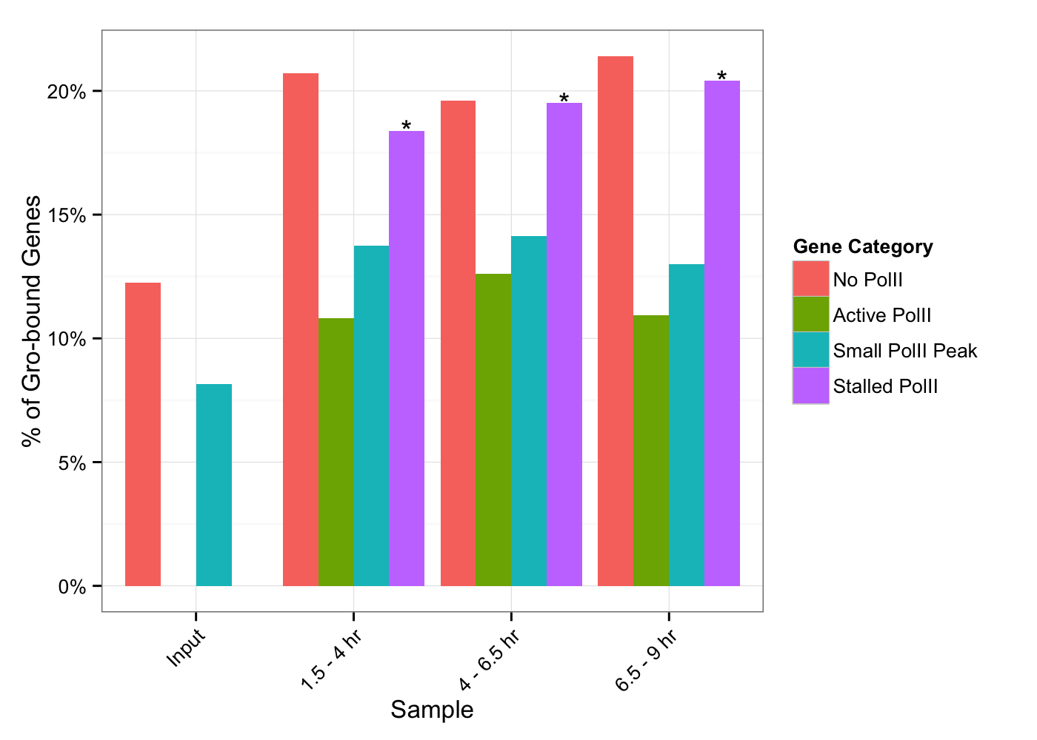
Fig. 2-22

Slide 24
z-score
1.5 – 4 hr
4 – 6.5 hr
6.5 - 9 hr

Slide 25
z-score
Anterior-posterior
Dorsal-ventral
1.5 – 4 hr
4 – 6.5 hr
6.5 - 9 hr

